Slide 1
AutoMarkAI – Smart Image Annotation Tool
Project II – AIML
CSPIT, Faculty of Technology & Engineering
Team: Chauhan Kunj, Shah Harsh
Notes:
1

Slide 2
Problem & Motivation
Manual Annotation: Time & Errors
Need for Automation
YOLO Integration
An urgent requirement exists for an automated annotation tool to accelerate dataset creation for machine learning applications.
Object detection models, specifically YOLO, can streamline annotation and enhance accuracy, forming the core of our solution.
Current image annotation processes are labor-intensive, leading to significant time consumption and human error, hindering dataset preparation.
Our motivation: To bridge the gap from image upload to object detection and finally to YOLO-format labels, creating an efficient pipeline.
Notes:
2

Slide 3
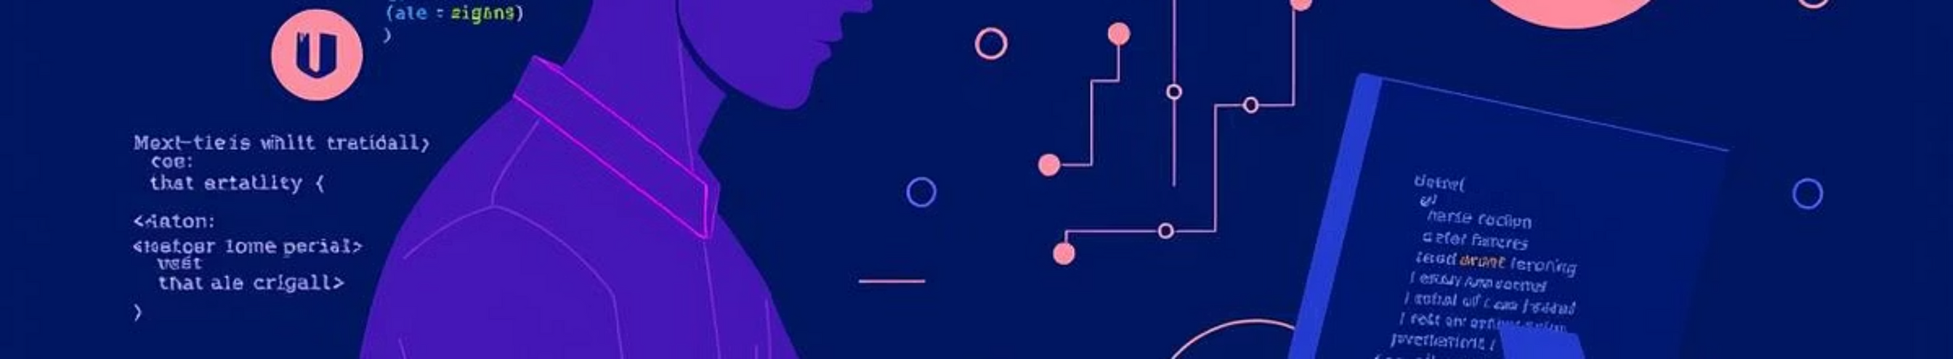
Requirements & Scope
Core Requirements
Project Scope
Backend: Python (FastAPI) for robust API services.
Fixed Object Classes: Initial support for common objects (Laptop, Mouse , KeyBoard , Headphone , SmartPhone ).
Frontend: React for an interactive user interface.
Object Detection: YOLOv8 for precise and fast detection.
Output: Generation of YOLO-format annotations crucial for downstream ML tasks.
Libraries: NumPy, Pandas, Matplotlib for data handling and visualization.
Notes:
3

Slide 4
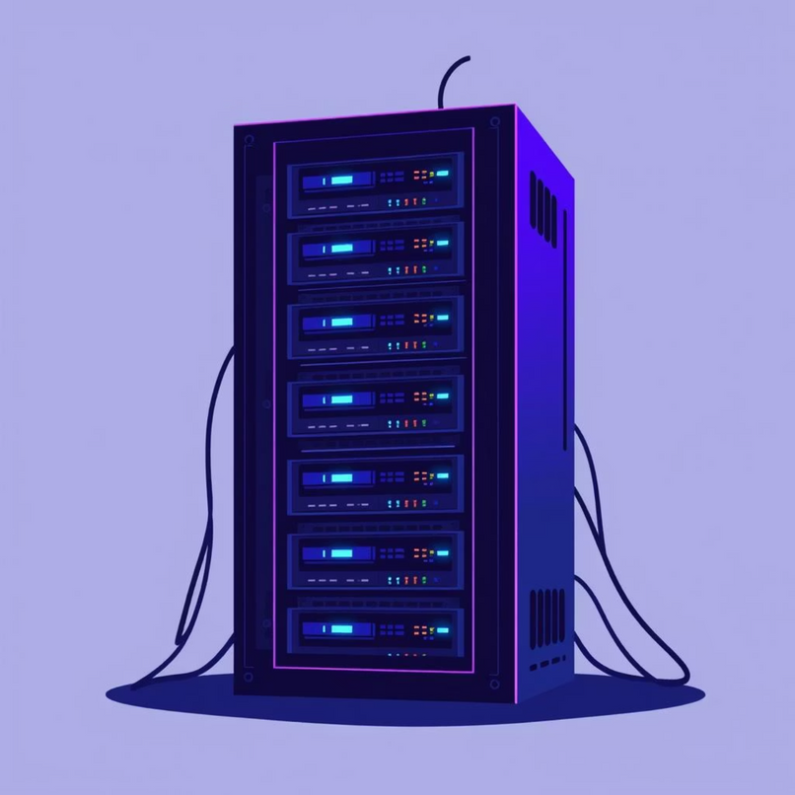
Solution Approach & Tech Stack
Solution Approach
Key Technologies
Frontend: React, CSS/Bootstrap
Dataset Collection
Data Preprocessing
Backend: FastAPI (Python)
Gathering diverse datasets, including open images and specific electronic datasets.
Cleaning, normalization, and initial annotation of collected data.
ML Model: YOLOv8
Tools: Jupyter Notebook
YOLO-based Detection
FastAPI Backend
Training and testing using YOLOv8, with provisions for transfer learning and augmentation.
Developing a robust backend for efficient model inference.
React Frontend
Building an intuitive UI for image uploads and annotation preview.
Notes:
4

Slide 5


Project Planning & Teamwork
Milestone Timeline
Team Roles
Week 1–2
Idea finalization, YOLO basics study.
Kunj
Week 3–4
Backend Development & ML Model Training
YOLOv8 testing, annotation script, fixed object classes.
Week 5
YOLO detection script, React frontend planning.
Harsh
Week 6
Frontend Development & Dataset Preparation
Integrated FastAPI + React (end-to-end basic UI).
Week 7
Collected electronic dataset (keyboard, mouse).
Week 8
Learned augmentation, transfer learning, explored pre-trained models.
Notes:
5

Slide 6

Progress & Demo Status
Completed Task
Pending Tasks
Backend and frontend are successfully connected, enabling image upload to YOLO detection and annotation.
Applying essential data augmentation techniques to enhance dataset robustness.
Fine-tuning the YOLO model with newly acquired custom classes.
Initial dataset collection for custom classes (keyboard, mouse) is complete.
Extensive UI polishing and refinement to ensure a demo-ready and user-friendly frontend.
YOLOv8 has been tested and validated on fixed object classes.
Implementation for downloading annotation files in standard YOLO format is functional.
Notes:
6

Slide 7
Future Work
1
2
3
Augmentation & Retraining: Complete dataset augmentation and retrain the model with keyboard/mouse dataset.
YOLO Fine-tuning: Optimize YOLO pre-trained weights for improved performance.
Frontend Enhancements: Focus on UI/UX improvements for a seamless user experience.
4
5
Model Comparison: Conduct a comparative analysis of YOLO versus traditional CNN results.
Platform Deployment: Deploy AutoMarkAI as a full-fledged web-based annotation platform.
Notes:
7

Slide 8

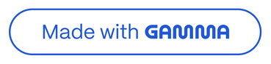
Thank You!
GITHUB
Notes:
8

